Slide 1
UNIT IV

Slide 2
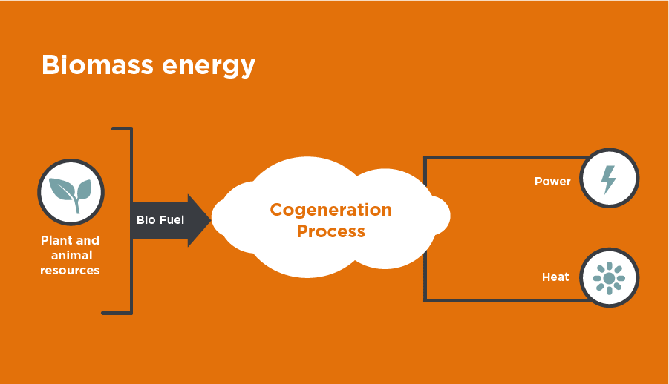
Biomass: Biomass is organic matter produced by plants both terrestrial (those grown on land) and aquatic (those grown in water) and their derivatives. It includes forest crops and residues, crops grown especially for their energy content on “energy farms” and animal manure. As the word clearly signifies; biomass means organic matter and photo chemical approach to harness solar energy means harnessing of solar energy by photosynthesis. Solar energy stored in the form of chemical energy. Hence Solar energy → Photosynthesis → Biomass → Energy generation.

Slide 3
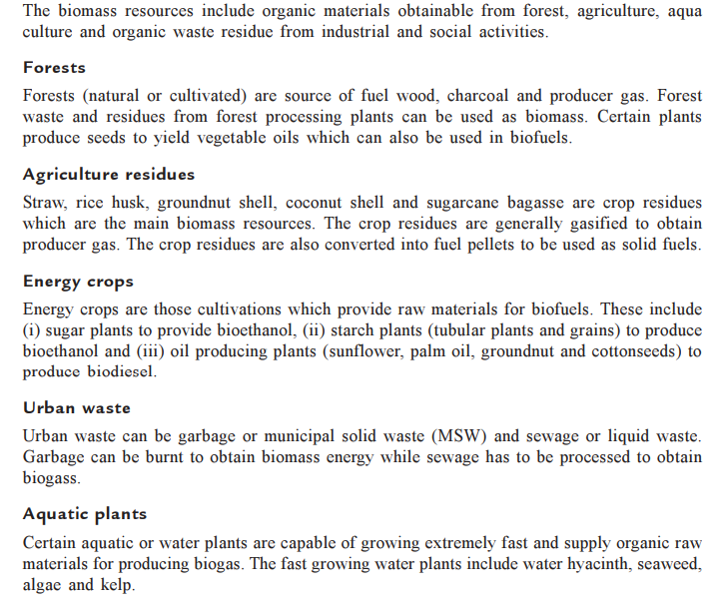
Biomass Resources:

Slide 4
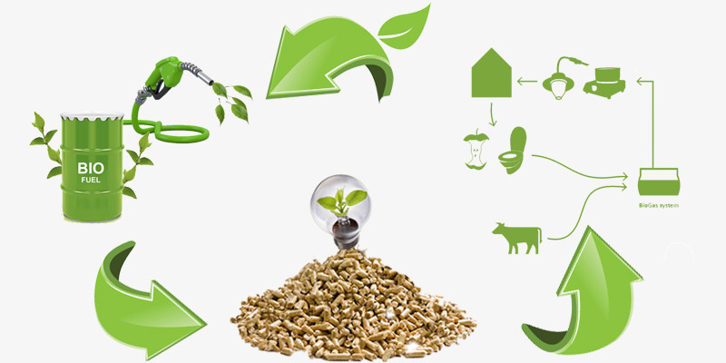
Bio-fuels: The energy stored in dry biomass like wood and straw is most easily released by direct combustion-although dry materials can also be converted into liquid and gaseous fuels (later combustion) by various techniques. Examples: Wood , straw and refuse etc..

Slide 5
Biomass – Energy generation: →Biomass power is simply carbon neutral electricity produced from renewable organic waste products, which could have been openly burned, dumped in land fills or just left in the forest to cause fires. 1.)Energy from the Sun is transferred and stored in plants in the form of chemical energy. When the plants are cut or die, wood chips, straw and other plant matter is delivered to biogas plant. When biomass is burnt, it releases energy in the form of heat. 2.)The biomass plants burn wood or other forms of waste to generate steam. The energy from the steam is directed via pipes to run turbines. 3.) The steam rises up to run turbines that produce electricity or generate heat for homes and industries. 4.)In most countries, biomass plants have been built in the country side to provide electicity for the local population. There are waste-to-energy plants that burn trash to produce electricity and power millions of homes. Energy can also be used by burning the scrap wood or wood chips that are left over after trees have been trimmed.

Slide 6
Biomass Conversion: A wide variety of conversion technologies is available for manufacturing premium fuels from biomass. Biomass Conversion Direct Combustion Thermo chemical Bio chemical conversion conversion Gasification Pyrolysis Anaerobic digestion Fermentation

Slide 7
Biomass Characterization: The biomass forms the basis of any Bio energy application and often the physical, chemical characteristics of the fuel also define the type of technology to be used. Characteristics affecting the wood as a fuel: → Heating value → Chemical composition → Moisture content → Density → Hardness →amount of volatile matters →amount of solid carbon →ash

Slide 8
HV - of biomass and some selected fuels are indicated below
Material | HV (kJ/kg)
Bituminous Coal | 17000 - 23250
Charcoal | 29600
Douglas fir | 21000
Douglas fir bark | 22000
Equcalypus grandis | 19400
Beech | 20300
Sugar cane bagasse | 17300
Wheat straw | 17500
Poplar | 20700
Rice hulls | 15300
Rice straw | 15800

Slide 9
Plant Biomass Chemical Composition:
 | Cellulose | Hemi-cellulose | Lignin
Softwood | 45 | 25 | 30
Hardwood | 42 | 38 | 20
Straw stalks | 40 | 45 | 15
The table below shows possible ranges in moisture content for selected biomass resources:
Biomass resource | Moisture content
Industrial fresh wood chips and sawdust | 40-60 wt. % (wb)
Industrial dry wood chips and sawdust | 10-20 wt. % (wb)
Fresh forest wood chips | 40-60 wt. % (wb)
Chips from wood stored and air-dried several months | 30-40 wt. % (wb)
Waste wood | 10-30 wt. % (wb)
Dry straw | 15 wt. % (wb)

Slide 10
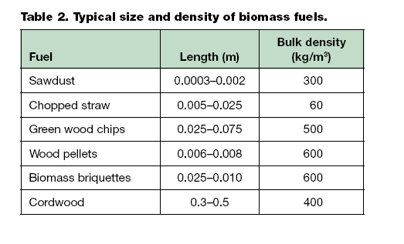

Slide 11
BIOGAS: Biogas is the mixture of gases produced by the breakdown of organic matter in the absence of oxygen (anaerobically), primarily consisting of methane and carbon dioxide. Biogas can be produced from raw materials such as agricultural waste, manure, municipal waste , plant material , sewage , green waste or food waste .Biogas is a renewable source. In India, it is also known as “ Gobar Gas". Biogas is produced by anaerobic digestion with methanogen or anaerobic organisms, which digest material inside a closed system, or fermentation of biodegradable materials. →Aerobic and Anaerobic Processes: Aerobic -- In the presence of air Anaerobic – In the absence of air or oxygen → Aerobic Process: An aerobic process refers to a process that requires the presence of oxygen or air as opposed to an anaerobic process that does not require it

Slide 12
→Anaerobic Digestion: It is the anaerobic process or digestion in biomass slurry which helps in converting biomass into biogas. The biochemical process of converse in from biomass to biogas takes place in the following three stages: (i) Hydrolysis of organic matter (ii) Anaerobic and faculative microorganisms (iii) Digestion → Advantages of Anaerobic Digestion: * Helps to obtain energy from discarded or waste matter. * Helps in conserving complete nitrogen content of the biomass. * Helps in waste management of an industry. * Helps in Urban waste management. * Helps in containing and controlling the odours of solid and liquid wastes.

Slide 13
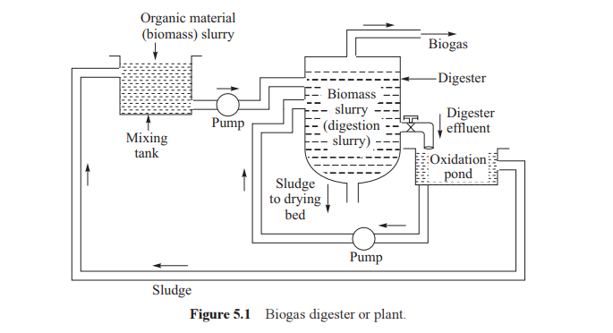
Digester:

Slide 14
Digester: The anaerobic digester (or) plant is shown in figure. Feed consists of organic material slurry prepared in mixing tank. Feed supply per day to the digester is called the loading rate. Neither overloading or under loading of the digester is desirable as it reduces biogas production. The acid forming bacteria grows rapidly where as methane forming bacteria (anaerobe) grows slowly. To obtain maximum biogas generation rate , seeding of digestion slurry with methane forming bacteria is done. This is achieved by adding certain portion of digested slurry to the fresh slurry. It is also possible to add nutrients containing nitrogen, hydrogen, oxygen, sulphur and carbon which can increase the anaerobic digestion rate. The recommended pH for the digestion of biomass slurry is about 7-8.

Slide 15
Factors affecting the performance of a digestor: → Temperature → Pressure → Water → pH Value → Feeding Rate →Presence of nutrients → Seeding → Mixing and Stirring → Retention time → Toxic Substances → Type of Biomass Type of Biomass: The digestion process also depends on type of biomass. The biomass can be cow dung, poultry manure, sheep manure, night soil, rice husk, algae and water which have a different rate of biogas yield per unit mass.

Slide 16
Properties of Biogas: → Composition: Methane 60%, carbon dioxide 40% and traces of hydrogen, hydrogen sulphide and other gases. → Calorific Value: Calorific value 5160 kcal/m3 or 4250 kcal/kg → Stoichiometric air fuel ratio: The stoichiometric air fuel ratio is 5.27 by volume. → Calorific value of mixture : It is equal to 767 kcal/m3 that is 85% of gasoline. Classification of Biogas Plants: Biogas plants can be classified as (i) Batch type (ii) Continuous type (a) Floating drum or constant pressure type plant (b) Fixed dome or constant volume type plant

Slide 17
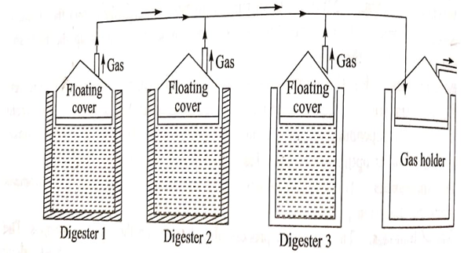
BATCH TYPE OF BIOGAS PLANT
Fig : Batch Type of Biogas Plant

Slide 18
BATCH TYPE OF BIOGAS PLANT: A batch type plant consists of a number of digesters which are charged, used and emptied one by one in a synchronous manner to maintain regular supply to gas holder (or) storage tank. Each digester is charged with fresh biomass and it starts supplying biogas after 8-10 days. The digester is now capable of supplying biogas for about 40-50 days till it’s biomass is completely digested. Hence each digester should be charged in about at an interval of 50-60 days. Digester in a batch biogas plant is shown in the above figure. The installation and operation of batch type plant is both capital and labour.

Slide 19
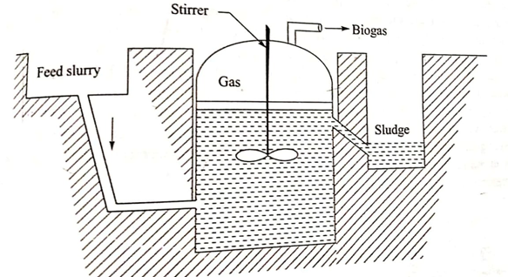
CONTINUOUS TYPE BIOGAS PLANT
Fig: CONTINUOUS TYPE BIOGAS PLANT

Slide 20
CONTINUOUS TYPE BIOGAS PLANT The continuous type of biogas plant , a certain quantity of biomass slurry is fed daily into the digester. This is made possible by the removal of slurry through an outlet so that the digester can have space to intake fresh biomass slurry. The biogas produced is either stored in the digester (or) removed to be stored in a gas holder. The plant operates continuously and it stopped only for the removal of sludge. The layer of slum at the top of the biomass slurry is periodically broken with the help of the stirrer as shown in the figure. The stirring also helps in better mixing of biomass slurry to speed up the digestion process. This type of plant is most suitable for individual house owners as the daily wastage can meet the biomass feed requirement of the digester.

Slide 21
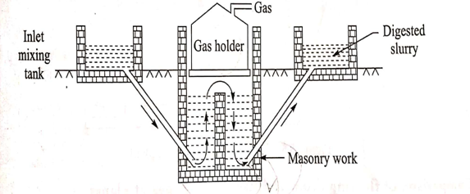
FLOATING DRUM TYPE BIOGAS PLANT
Fig: FLOATING DRUM TYPE BIOGAS PLANT

Slide 22
FLOATING DRUM TYPE BIOGAS PLANT: The digester chamber is provided with a partition wall at the centre so that optimum condition is for growth of acid forming bacteria and methane forming bacteria can be provided in the partitioned portions as biomass slurry should be acidic and basic for acid foaming and methane foaming respectively. The pipe arrangements are provided to the digester for the supply of feed of biomass slurry and the removal of digested slurry. As digested slurry has floating gas holder , the pressure inside the digester remains constant. There is no risk of explosion due to prevailing low pressure of gas.

Slide 23
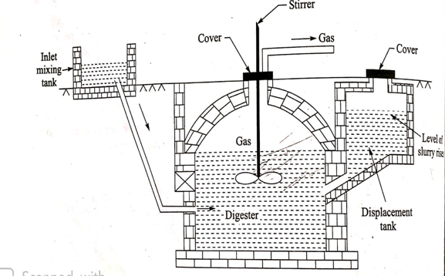
FIXED DOME TYPE OF BIOGAS PLANT
Fig : FIXED DOME TYPE OF BIOGAS PLANT

Slide 24
FIXED DOME TYPE OF BIOGAS PLANT It has constant volume but varying pressure inside the digester as it has no movable type gas holder but a fixed dome at the upper portion of the digester as shown in figure. The biomass and water are mixed into slurry in inlet mixing tank, which is fed into the digester through the inlet pipe. A stirrer is provided in the digester tank to mix the slurry inside the digester, which also helps in mixing up of scum floating on the slurry. The generated biogas accumulates in the fixed dome of the digester and it is taken out from an opening in the digester. In the modified fixed dome type of biogas plant, a displacement tank is also provided which is connected to the digester. As the pressure of the gas in the fixed dome increase, the level of slurry inside the digester goes down and it forces the slurry to raise in the displacement tank. This arrangement helps in maintaining a constant pressure inside the digester about 1m of water column and the digested slurry from the displacement tank.

Slide 25
Comparison of floating drum and fixed dome plants
It has constant pressure.
Pressure is more than the atmospheric pressure.
No danger of explosion of gas in the digester.
No danger of leakage of gas.
Cost is more.
Corrosion of steel is likely.
More maintenance needed due to sliding metallic drum.
Gas production is high due to lower pressure.
Installation is simple.
It has constant volume.
Pressure can be as high as 1 m of water column.
Danger of explosion exists .
Due to high pressure there is danger of leakage of gas.
Cost is less.
There is no such danger.
Less maintenance needed.
Low production of gas.
Installation is difficult.

Slide 26
Advantages and disadvantages of floating drum type biogas plant:
Advantages :
Higher gas prodcution.
No gas leakage problem.
Constant Gas pressure.
Simple Installation.
Disadvantages:
Higher cost.
Has corrosion problem.
It requires maintenance.

Slide 27
Advantages and disadvantages of fixed drum type biogas plant:
The advantages are as follows:
It has lower cost.
It has no corrosion problem.
It has better heat insulation.
It requires no maintenance.
The disadvantages are as follows:
Gas production is less.
It has variable pressure of biogas.

Slide 28
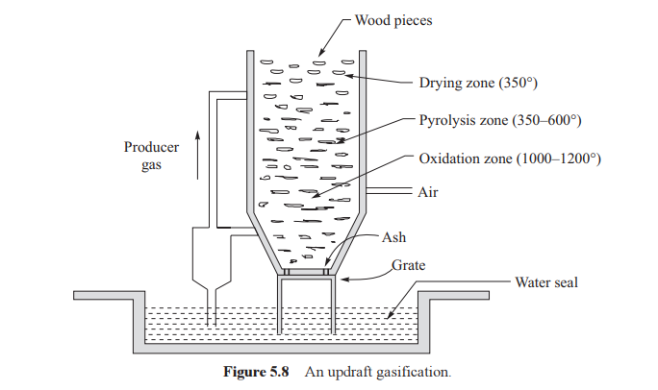
Biomass Gasification:

Slide 29
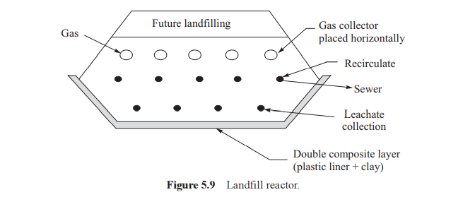
Landfill Reactor:

